Slide 1
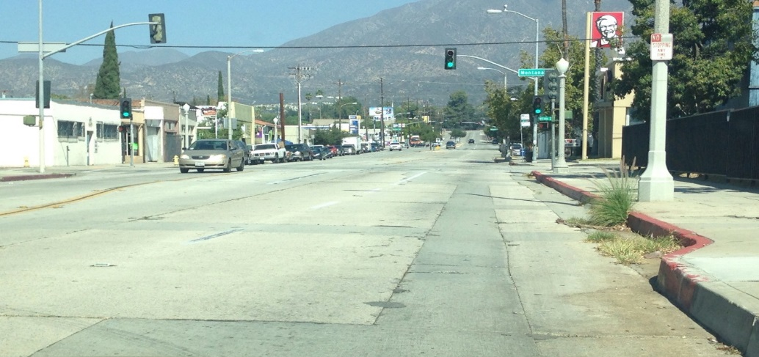
North Fair Oaks Empowerment Initiative
Community Transformation
for the Community, by the Community

Slide 2
Our Mission
To be repairers of the broken walls and the restorers of the streets
Isaiah 58:12
To create a team of empowered leaders to restore a blighted neglected area of the city, from Howard to Woodbury on N. Fair Oaks to its
to it’s once vibrant and thriving business community that is safe for its residents.

Slide 3
Our Goal(s)
To activity engage N. Fair Oaks Churches, Business Owners and Residents in the revitalization and beautification of their community as they see it
To secure city funding as needed and necessary for the revitalization and beautification of this neglected part of the city
That will ultimately result in
Beautification without Gentrification and Displacement
This community needs to be ahead of the curve.
Participating in creating a plan can and will accomplish that.

Slide 4
Our Partners- IMA
Interdenominational Ministerial Alliance–(an association of African American pastors that has been active in Pasadena for nearly 80 years) They have and continues to be on the cutting edge of Justice for minorities. Their efforts to bring mutual respect, and harmony to the City of Pasadena through inspirational moral leadership have included several paramount civil rights victories for the city.
In recent years they have been doing resource fairs for this community, mostly with a focus as a “job fair”
But the fairs were for the community not by the community.

Slide 5
Our Partners- N Fair Oaks Churches, and the city of Pasadena
Interdenominational Ministerial Alliance–(an association of African American pastors that has been active in Pasadena for nearly 80 years) They have and continues to be on the cutting edge of Justice for minorities. Their efforts to bring mutual respect, and harmony to the City of Pasadena through inspirational moral leadership have included several paramount civil rights victories for the city.
In recent years they have been doing resource fairs for this community, mostly with a focus as a “job fair”
But the fairs were for the community not by the community.

Slide 6
The complete Streets Coalition

Slide 7
Our History
We have work long and hard, starting May, 2015, when we partnered with churches to survey the community, to find out the concerns and dreams of the 18 businesses, 10 churches and residents between Woodbury and Howard. From this effort community leaders emerged to help plan the highly successful Northwest Job Fest where the community came together for a fun festive day applying for jobs, free haircuts, dress shirts, games for kids of all ages, audition for adults to be on the stage where pastors and dignitaries also stood celebrating the neighborhood and its history and talent.
In response to the safety concerns about the 65,000 cars speeding down Fair Oaks, in 2016 we hosted the NW Gathering in partnership with the Complete Streets Coalition began efforts to gain the support of the North West Commission and Councilmember Hampton so we could realize our dreams for North Fair Oaks. The community came out and spoke at Commission meeting presenting a list of 15 “ASKS”.
In 2017 we enjoyed Walking the Corridor with Councilmember Hampton and other city staff who shared information to assist us in our efforts to move forward. The Transportation Advisory Committee voiced unwavering support. We wrote to the Pasadena City Council and attended multiple Council meetings to present our letters with 87 signatures of people within our N Fair Oaks corridor.
We enjoyed the Damascus Road Church Mission Team that came from Tucson, AZ during spring break for a week. They painted over graffiti, played with kids, spent time with elderly disabled neighbors in two N Fair Oaks nursing homes, and to roll up their selves to clean up on the street. Estella at Rio Meat Market’s opened her doors.
May 8th, 2017 Council Victory ! We won 7 of the 15 items we asked for!!

Slide 8
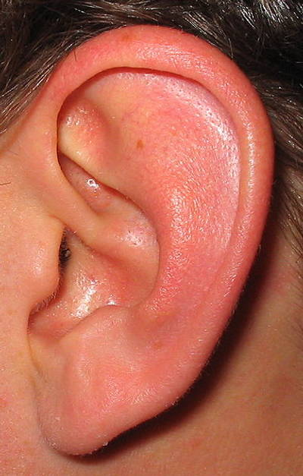
Our Strategy: Phase 1: Listening-Surveys and Fund Raising
Our team is surveying the:
10 Churches
18 Businesses
Many Nonprofits (nursing homes)
Residents
Our goal was to survey 50% of the target area from Woodbury to Howard by mid-July and we met that goal.

Slide 9
Survey totals and results
150 surveys conducted (we have a copy of the survey in English and Spanish in your packets)
We have a list of the results (we a copy of this for you in your packets)
Notes:
Maria

Slide 10
Churches connecting with a Purpose Results of the survey
Bethel Church, located at 1972 N. Fair Oaks, where Reverend John Mc Call is senior pastor hosted a potluck in May, 2015, where we partnered with 10 churches to review the results of the surveys to find out the concerns and dreams for N. Fair Oaks between Woodbury and Howard.
Many thanks to:
Pastor John Mc Call, Bethel Church, Reverend John B. Bledsoe, Zion Star Missionary Baptist Church, Reverend John Stewart, New Guiding Light Missionary Baptist Church, Reverend Sterling Brown, Greater New Guide Baptist Church, Reverend John Higgins, New Hope Baptist Church, Reverend Miguel Rios, Ebenezer Church, Reverend Christopher Bourne, Bethlehem Church of Christ Holiness, Reverend Othella Medlock, New Life Holiness Church, Reverend James Jackson, Good Shepard Church, and Reverend Gladys Jackson, Harvest Time Fellowship Church of God

Slide 11
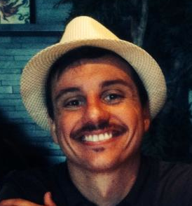
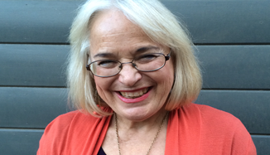
Phase 2: Planning a Common Goal and Resource Fair
we had a potluck, gathering all those we have surveyed to hear the survey results and to choose one issue to work on.
That night we also created a team to begin planning the Resource Fair with and by the neighborhood.

Slide 12
Planning the Fair: Churches, Businesses and Residents connecting for the purpose of engaging the entire Community 7 of the 10 churches in our target area have sent representatives to be part of our planning meeting
The planning team that emerged met 15 times at the New Hope Church, located at 1787 N. Fair Oaks, to plan the Fair. Planning committees and the tasks of part time staff included:
City Permits
Door prizes, discount cards and N Fair Oak business directory.
Budget and Fund raising
$16,000 was raised!
Including $5,000 from the City of Pasadena and $3,000 from our fundraiser)

Slide 13
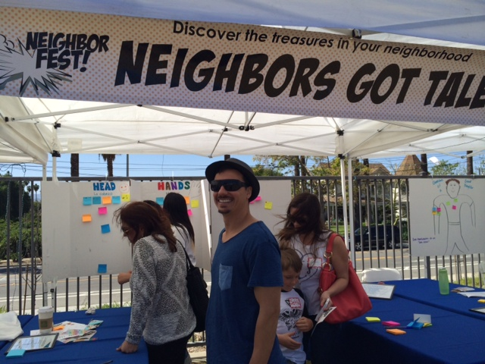
The community itself becomes part of the resource Fair
I had no idea you loved to dance!

Slide 14
Fund Raising for the Fair-Mustard Seed Grant Match
Dead Sea Scrolls & The Untold Story of Africans in the Bible
Presented Dr. Jamal-Dominique Hopkins
Friday, July 24, 2015 7:00 – 9:00 PM
Greater New Guide Baptist Church
Reverend Sterling Brown, Senior Pastor
2162 Summit Avenue
Altadena, CA
Suggested Donation: $10.00
Donations will be matched and go to
N. Fair Oaks Empowerment Project

Slide 15
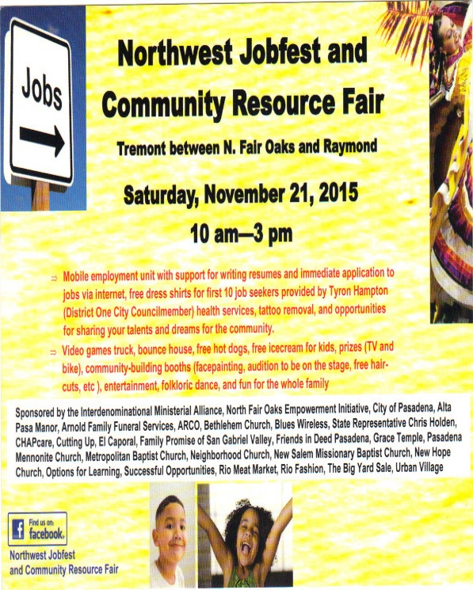
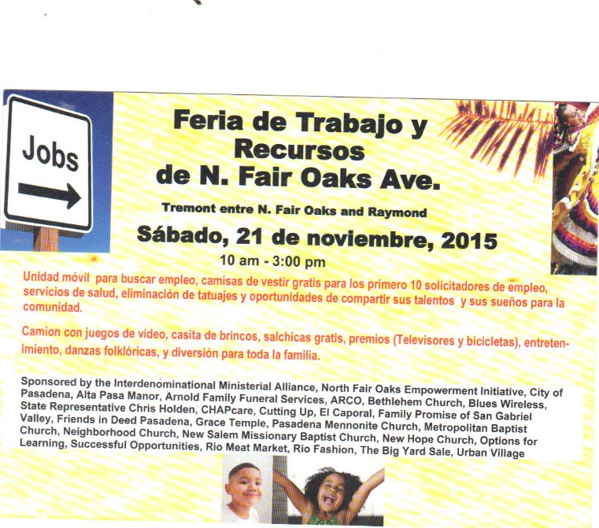
The Fair A Jobfest and Resource Fair for and by the community
Over 500 attended! Hope for a vibrant community was being restored!
Perceptions were changing! The community is forming a collective voice
Leaders are emerging for the next Phase!

Slide 16
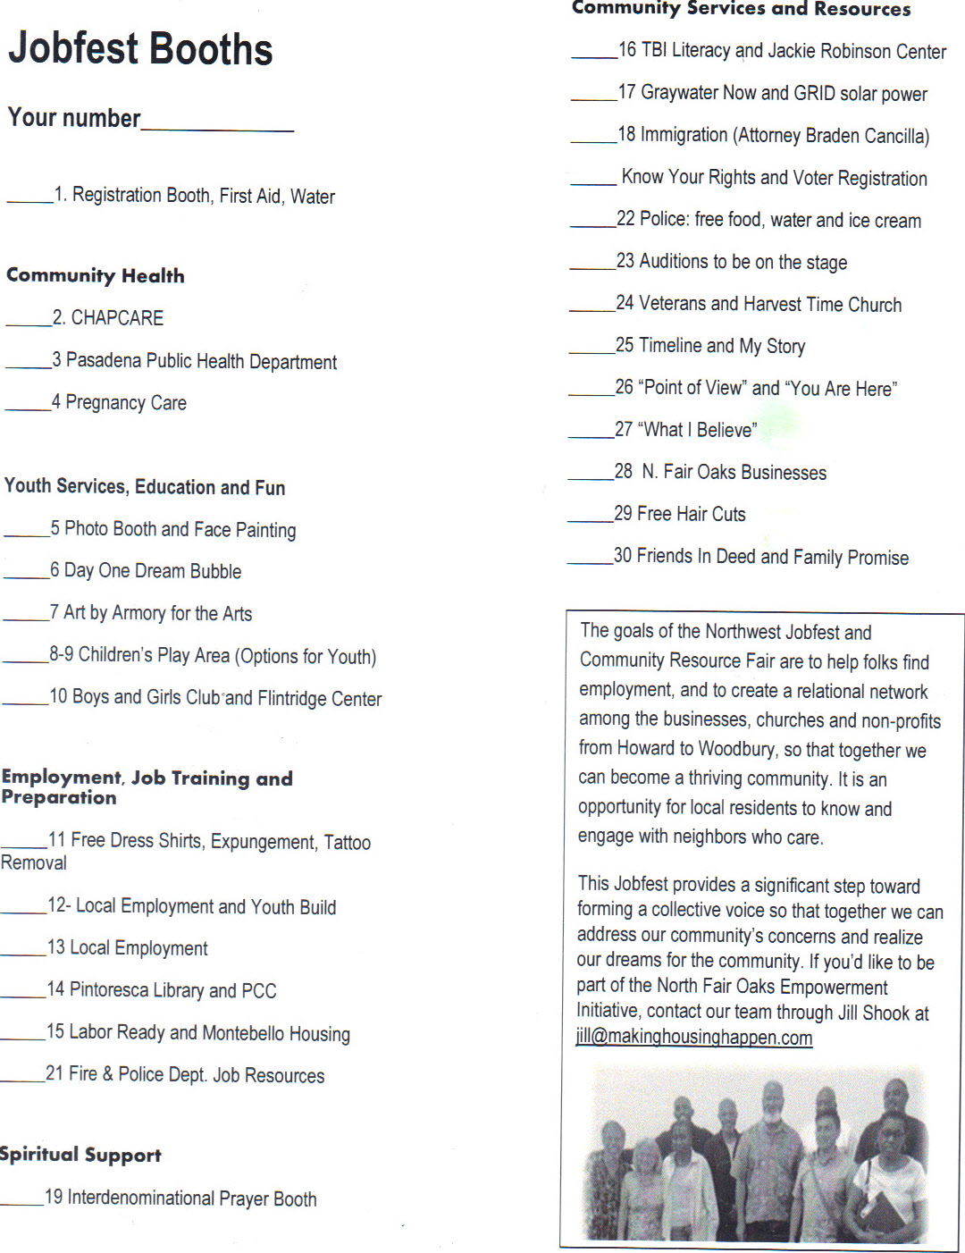
The Fair Booths

Slide 17
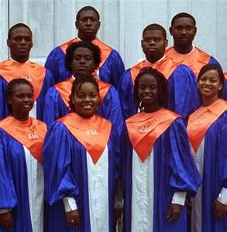
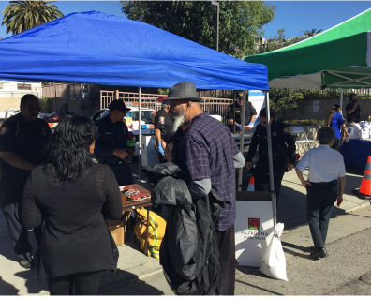
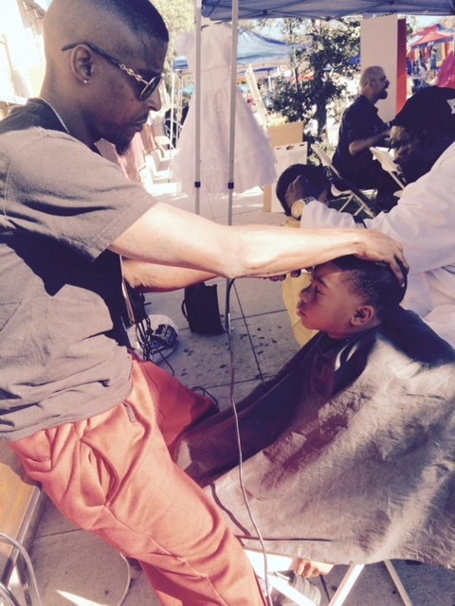
The Fair Activities

Slide 18
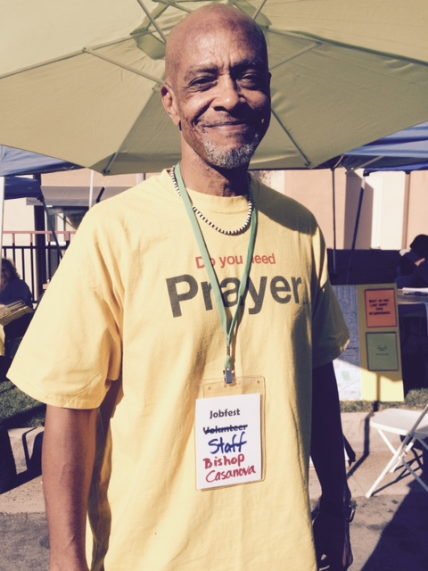
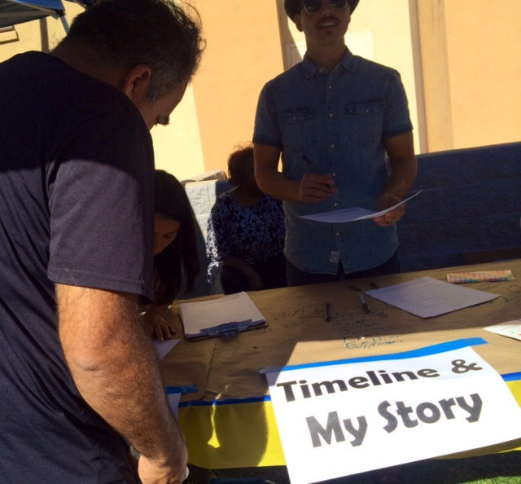
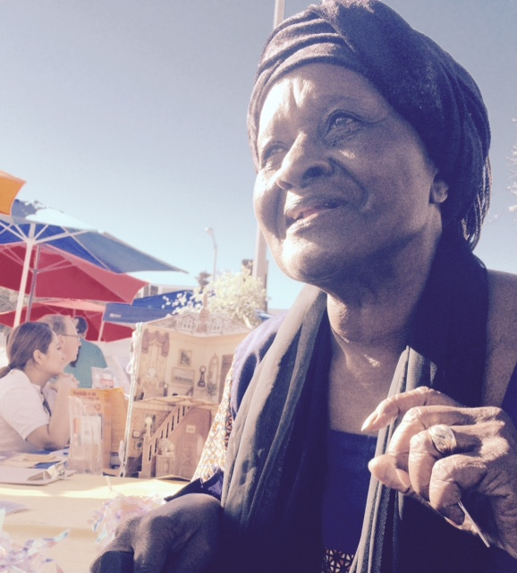
The Fair The community Connects
Prayers were prayed, beliefs were shared,
their stories were told, and Best Neighbors nominated

Slide 19
“You and your team did such an amazing job. With the 35 years I have lived in this community I have never seen anything like this”--Andrea

Slide 20
Huge Results!
Over 500 attended!
Hope for a healthy community was restored!
Perceptions are changing!
A community is forming with a collective voice
Leaders are emerging for the next Phase!
We have street cred—a known name as the N. Fair Oaks Empowerment Initiative.

Slide 21
Phase 3: Create an ongoing “dream team”
Create an ongoing “dream team” made up of those in the neighborhood, with some outside peer coaching and support to assure success.

Slide 22
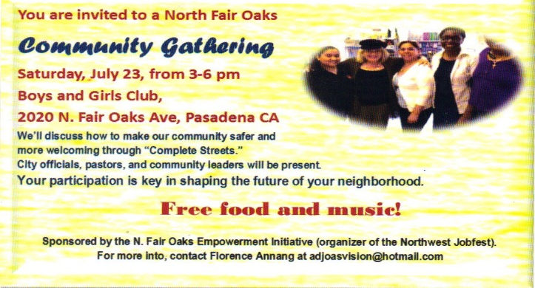
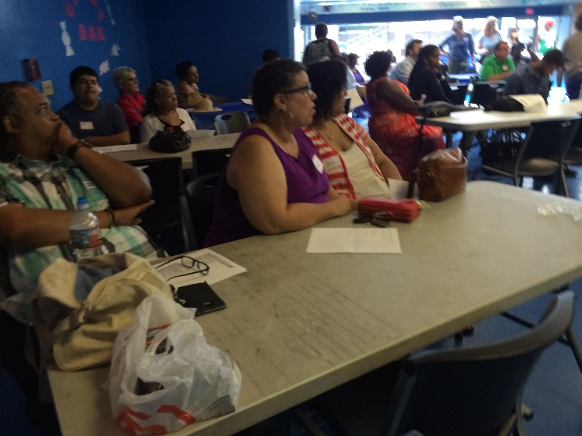
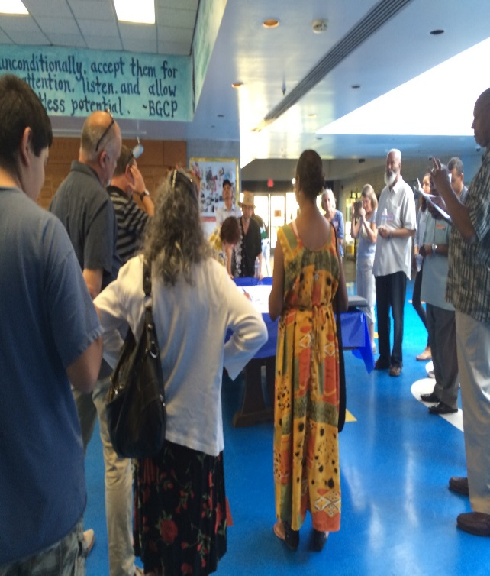
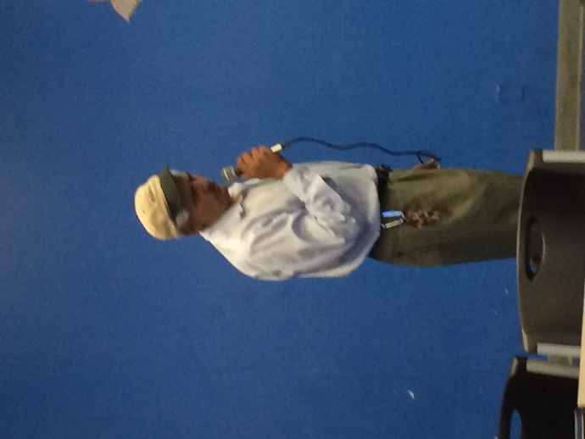
NW Gathering in partnership with the Complete Streets Coalition

Slide 23
The Results of the Focus groups “Our Asks”

Slide 24
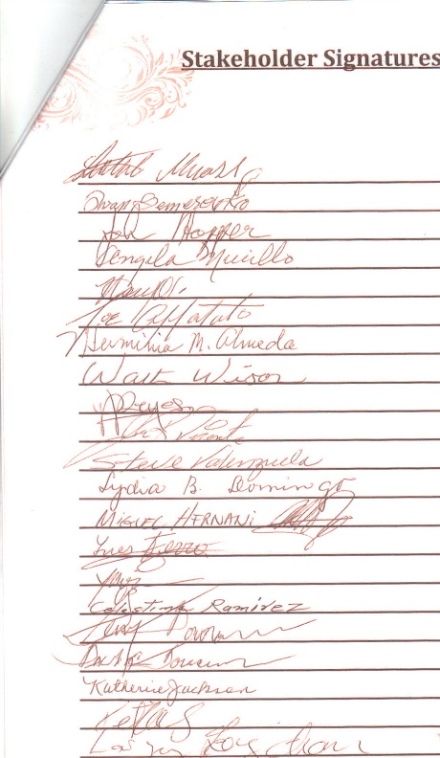
Our Councilmember and City Council

Slide 25
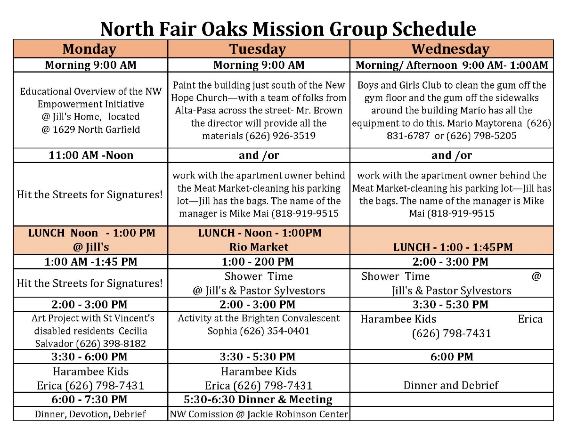
Damascus Road Church Mission Team

Slide 26
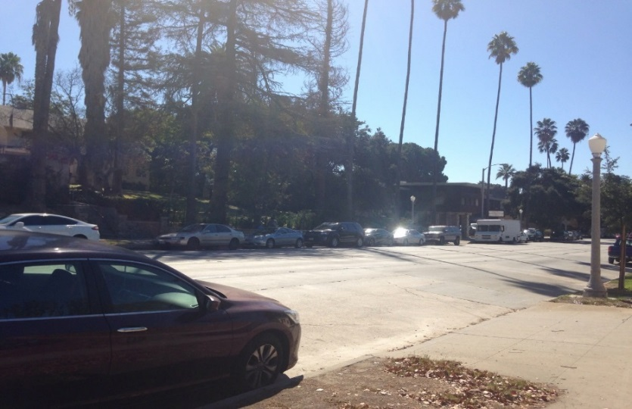
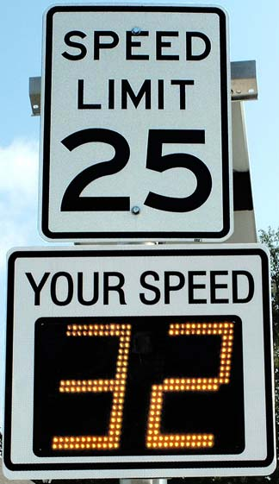
City Council unanimously voted to fund Four (4) of the 15 Asks
Long asked for Safety items in the City’s 2018-2022 CIP Budget.
At the May 8th the City Council unanimously passed the fiscal year 2018-2022 Capital Improvement Program (CIP) budget that included funding for four more of our list of 15 things we asked for.
Investigation into improving the visibility of the crosswalk at N. Fair Oaks and Montana, in the next 6 to 8 weeks with recommendations following thereafter.
Installation of electronic speed feedback signs at 1329 North Lake Ave. at Washington and on the West side of Fair Oaks Ave. between Howard St. and Montana St. by June 30, 2018.
A new crosswalk with a traffic signal between 1787 and 1790 North Fair Oaks to be installed by June 30, 2019.
More bike racks and street benches to be installed by June 30, 2018. City staff will work with us and the NW Commission identify locations.
Four other “Safety” requests for changes in the North Fair Oaks corridor will be studied in the year-long comprehensive Complete Streets overview. Results of that study are expected to be available by June 30, 2018.
In his remarks Vice Mayor, Council member Kennedy noted the significant pedestrian traffic of predominately seniors, children and vulnerable persons, for whom the city is responsible for ensuring a safe public environment.

Slide 27
To date we have successfully accomplished
Completed March , 2017
Signage
More Trees
City Of Pasadena

Slide 28
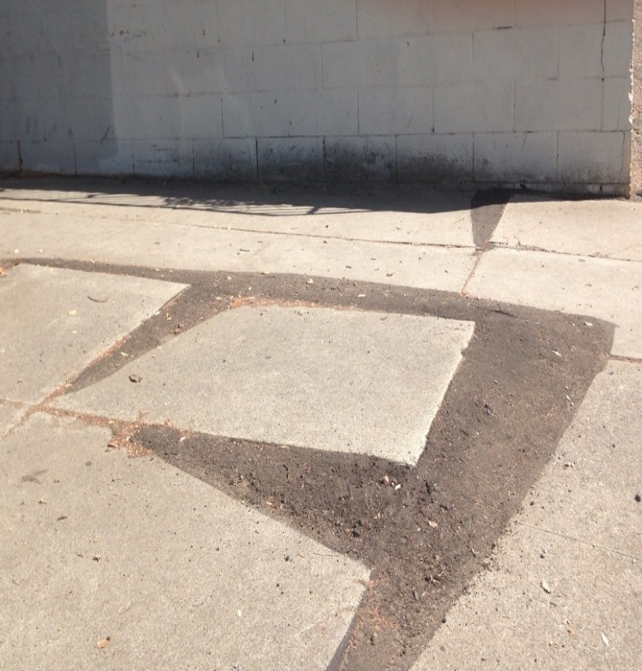
To date we have successfully accomplished
Side Walk Repairs
Approved prior to May 8, 2017 need to follow up with Councilmember’s office

Slide 29
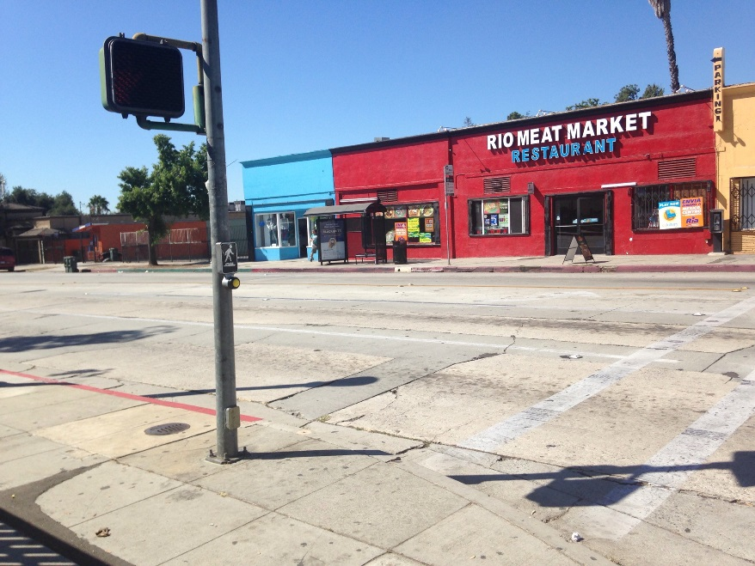
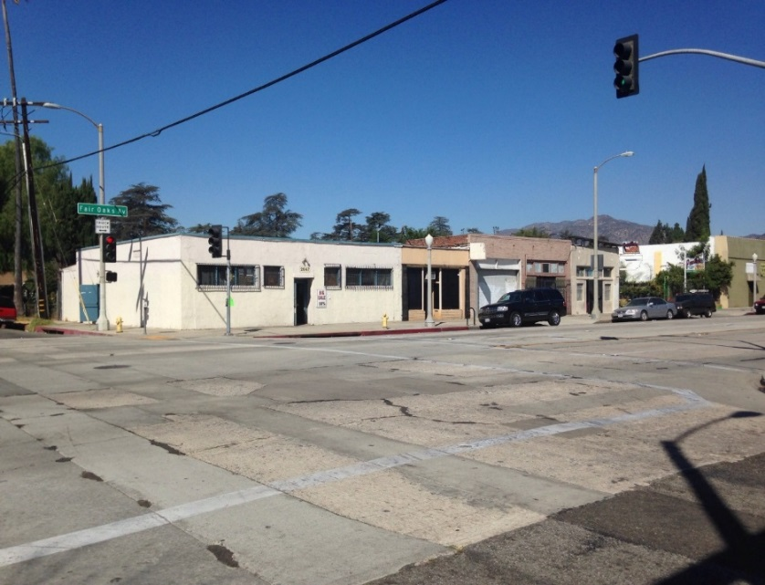
Items Funded in CIP 2018-2022 Budget
Strengthen the cross walk at Montana

Slide 30
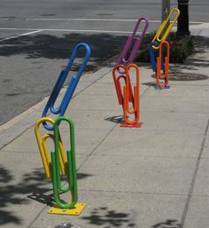
Items Funded in CIP 2018-2022 Budget
Benches and Bike Racks
by June 30, 2018. City staff will work with us and the NW Commission to identify locations.

Slide 31
Items Funded in CIP 2018-2022 Budget
Speed Monitor to register speed limits
on the West side of Fair Oaks Ave. between Howard St. and Montana St. by June 30, 2018.

Slide 32
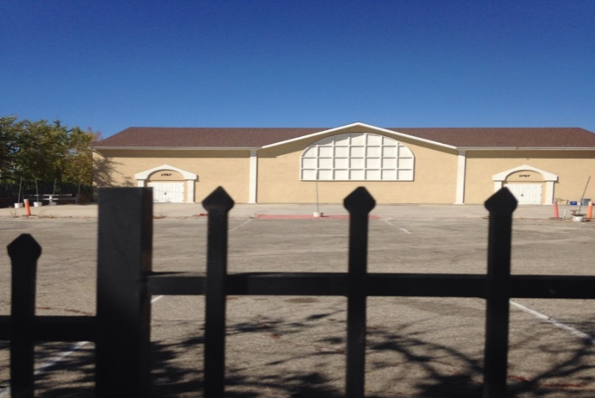
Items Funded in CIP 2018-2022 Budget
A crosswalk at Alta Pasa and New Hope Church
1787 and 1790 N. Fair Oaks,
Funding includes a signal! Huge!!
Construction should begin in April 2019

Slide 33
Items Funded in CIP 2018-2022 Budget
Four other “Safety” requests for changes in the North Fair Oaks corridor will be studied in the year-long comprehensive Complete Streets overview.
Results of that study are expected to be available by June 30, 2018.
1. Caution Sign near the Boys and Girls Club
2. Repaving the street with noise reducing pavement
3. Removal of Red zones to be replaced with limited parking times
4. Pocket/angled Parking

Slide 34
Remaining items and Future plans to Beautify and build community
Collaborate with Complete Streets to secure:
1. a Caution Sign near the Boys and Girls Club,
2. Repaving the street with noise reducing pavement
3. Removal of Red zones to be replaced with limited parking times
4. Pocket/angled Parking
Cleaner streets
Wider sidewalks for outdoor dinning
Store front improvements with distinctive color scheme and style
More business i.e. Coffee shop, frozen yogurt/ice cream
and to create jobs and community.

Slide 35
Remaining items and Future plans to prevent displacement and further gentrification
Create a Master Plan that includes land use affordability.
Just cause eviction laws (Like Glendale)
Relocation allowances for those being displaced (Like LA)
Incentivizing landlords to keep units affordable in exchange for solar and other green initiatives, and passing on the savings from solar to the residents ($3 for 2 months with solar at Jill and Anthony’s home, vs. $125 a month at a low income apt at Agape Court)
Opportunities of homeownership for low-income homeowners, including the financial education, and credit repair and first time homeowners financial assistance for affordable homeownership (like Housing Heritage Partners)
Allowing more financial viability by creating a secondary dwelling unit to be rented out (which also help renters to stay)
Allow higher density so that affordable units will be included (with IZ ordinance setting aside 15%)
Strengthen the IZ so that the in lieu fees are high enough to encourage the units to be built
Strengthen public transport, bike lanes and other forms of transport to have less car reliance, (parking is one of the biggest expense of housing).

Slide 36
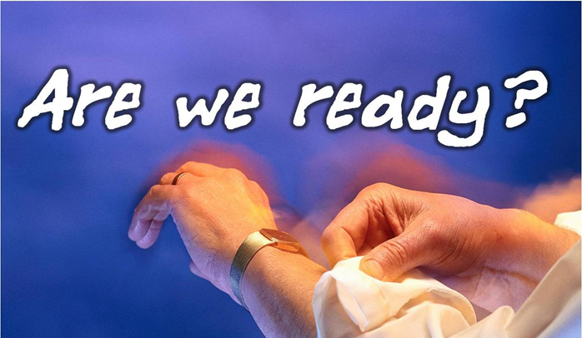
We are just getting started
We have received 7 of our 15 items on our ask list
We need to oversee the implementation of the items to be received as well as work on the remaining items and these future dreams.
How can we , will we do it?

Slide 37
Staff, training and capacity building needed to complete the job
The work ahead will require continued administrative assistant to oversee and coordinate, and collaborate with the city and community. This involves one-on-ones with stakeholders and key leaders, pastors, business owners,
Janet Randolph has been assisting our effort since late 2016.
Janet is a Pasadena 3rd generation Pasadena native that remembers
N. Fair Oaks when it was a vibrant and safe community and
Today Pastor John Steward, of the New Guiding Light Missionary Baptist Church works with MHCH two hours a week to continue building the relational network among the N. Fair Oaks Churches to get the job done.

